Slide 1
JAVA
Unit 7(b)

Slide 2
isAlive()
The isAlive() method of thread class tests if the thread is alive. A thread is considered alive when the start() method of thread class has been called.
Syntax: public final boolean isAlive()

Slide 3
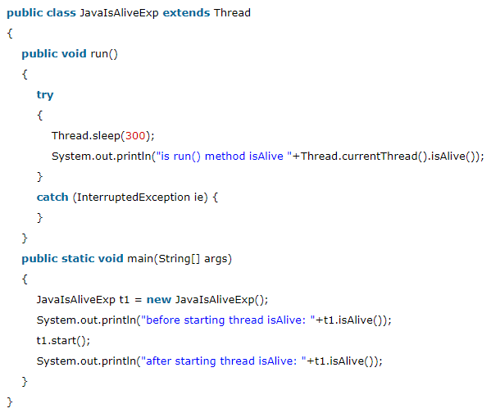

isAlive()
Output

Slide 4
join()
The join() method of thread class waits for a thread to die.
It is used when you want one thread to wait for completion of another.
It does not return any value.

Slide 5
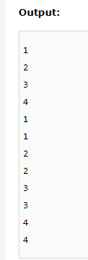
Join()
public class JoinExample1 extends Thread
{
public void run()
{
for(int i=1; i<=4; i++)
{ Thread.sleep(500);
}
public static void main(String args[])
{
JoinExample1 t1 = new JoinExample1();
JoinExample1 t2 = new JoinExample1();
JoinExample1 t3 = new JoinExample1();
// thread t1 starts
t1.start();
// starts second thread when first thread t1 is died.
try
{ t1.join();
} catch(Exception e){System.out.println(e);}
// start t2 and t3 thread
t2.start();
t3.start(); } }

Slide 6
Thread priority
https://www.geeksforgeeks.org/java-thread-priority-multithreading/

Slide 7
Synchronization in Java
Synchronization in java is the capability to control the access of multiple threads to any shared resource.
Java Synchronization is better option where we want to allow only one thread to access the shared resource.
Java provides a way of creating threads and synchronizing their task by using synchronized blocks.
Synchronized blocks in Java are marked with the synchronized keyword. A synchronized block in Java is synchronized on some object. All synchronized blocks synchronized on the same object can only have one thread executing inside them at a time. All other threads attempting to enter the synchronized block are blocked until the thread inside the synchronized block exits the block.

Slide 8
Synchronization in Java
Synchronized keyword is only applicable on methods, can’t apply for classes and variables.
Synchronized keyword creates a block known as critical section.

Slide 9
Synchronization in Java
https://www.javatpoint.com/synchronization-in-java

Slide 10
Interthread Communication
https://www.javatpoint.com/inter-thread-communication-example

Slide 11
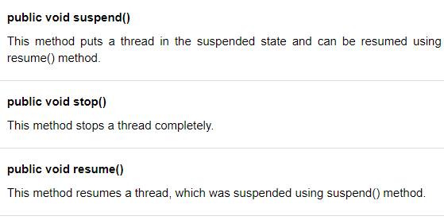
Suspending, Resuming and Stopping threads

Slide 12
Important note
The suspend() method of Thread class was deprecated by Java 2 several years ago. This was done because the suspend() can sometimes cause serious system failures. Assume that a thread has obtained locks on the critical data structures. If that thread is suspended at that point, those locks are not relinquished. Other threads that may be waiting for those resources can be deadlocked.
The resume() method is also deprecated. It does not cause problems, but cannot be used without the suspend() method as its counterpart.
The stop() method of Thread class, too, was deprecated by Java 2. This was done because this method can sometimes cause serious system failures. Assume that a thread is writing to a critically important data structure and has completed only part of its changes. If that thread is stopped at that point, that data structure might be left in a corrupted state. The trouble is that, the stop() causes any lock the calling thread holds to be released. Thus, the corrupted data might be used by another thread that is waiting on the same lock.

